Slide 1






MIDTERM REVIEW SESSION
COMMERCE MENTORSHIP PROGRAM
ECON 101
Prepared by: Shivani Aggarwal

Slide 2


TABLE OF CONTENTS
What is Economics
PPF, Gains from Trade
Demand & Supply
Elasticity
Surplus & Efficiency
Price Controls and Quotas
Taxes

Slide 3
1. What is Economics
Economics: social science that studies the choices individual people, businesses, government, and societies make to cope with scarcity
Scarcity: our inability to get everything we want due to limited resources
Trade-offs: must give up 1 thing if you want another
Microeconomics: focuses on the choices people and businesses make
Macroeconomics: focuses on the economy as a whole
Two economic questions:
What, how, for whom to produce?
When does self-interest promote social interest?

Slide 4
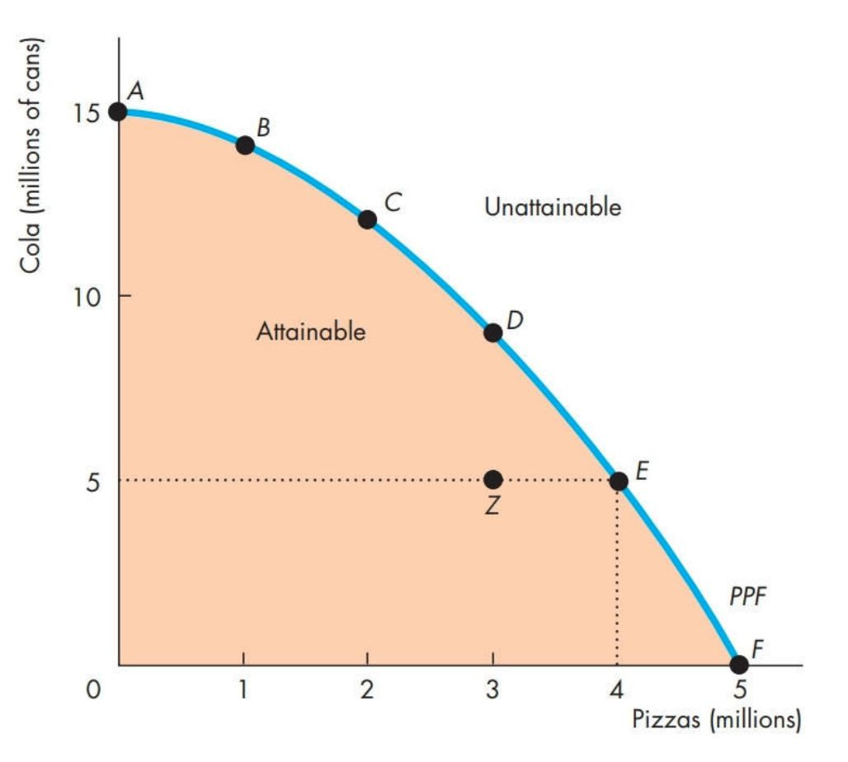
2. PPF
Production possibilities frontier (PPF): the boundary between the combos of goods/services that can & can’t be produced
all points on the curve are production efficient: goods/services are produced at the lowest possible cost and by using all resources optimally
Assumptions:
an economy only produces 2 goods at a time
ceteris paribus: other factors remain the same
Opportunity cost (OC): next BEST alternative given up in order to get something else
OC of good A = # of good B given up

Slide 5
2. PPF
Q1: Explain why the PPF curves outwards (concave shape)?
Q2: How can the PPF be pushed inwards?

Slide 6
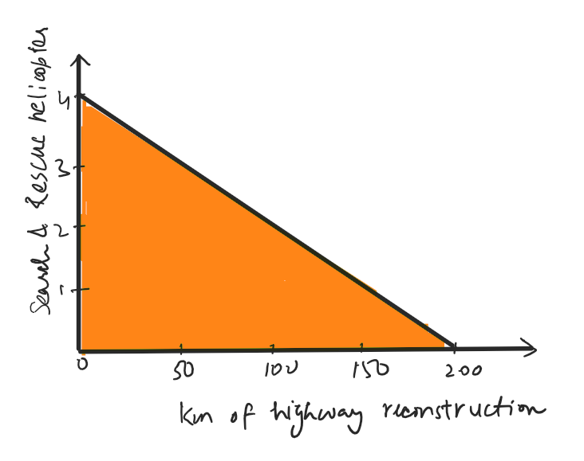
2. PPF
Q3: With a budget of $200 million, the government can choose to purchase 4 helicopters or repair 200 km of highway.
If the government chooses to allocate all $200 million to highway repair, we can say that
There is no opportunity cost involved because the government stayed within its budget
The opportunity cost of highway repair is 4 search and rescue helicopters
There is no opportunity cost involved because the government has achieved its objectives
The opportunity cost is different for every km of road built. Therefore, it cannot be calculated as an aggregate

Slide 7
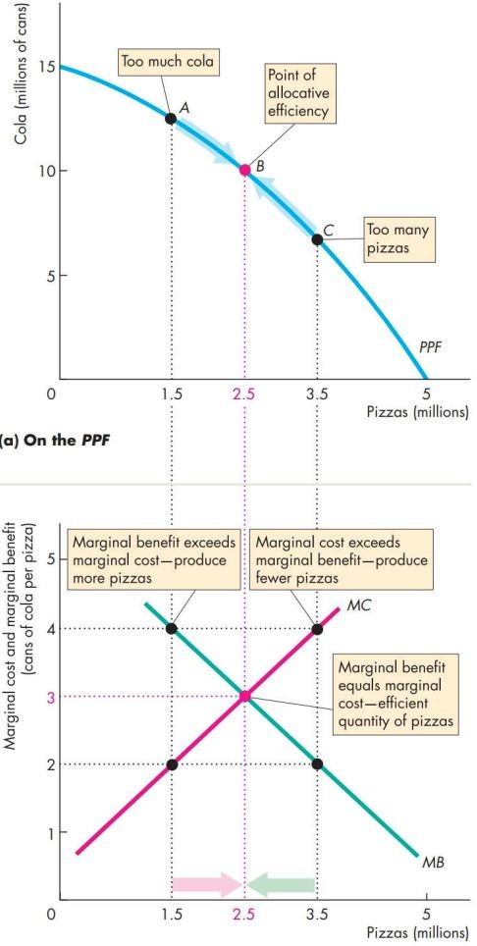
2. PPF - Using Resources Efficiently
Marginal cost (MC): OC of producing an additional unit
Marginal benefit (MB): benefit from consuming an additional unit
measured by people’s willingness to pay for that additional unit
the more we consume it, the lower the marginal benefit we receive due to Diminishing Marginal Utility
Allocative efficiency: when a market player can achieve highest possible benefit at lowest possible cost such that any other use of resources would involve lower benefits per unit costs
MC = MB → producing the most efficient combination of the 2 goods, at equilibrium (EQM)

Slide 8
2. Gains From Trade
Absolute advantage: when a person is more productive than everyone else
Comparative advantage: when a person performs an activity at a lower OC than everyone else
Comparative advantage → specialization → trade
Trading price: Seller’s OC ≤ P_{good} ≤ Buyer’s OC
Steps to Approaching Gains from Trade Problems:
Calculate the OCs
Determine who has a lower OC for each good as they will specialize in the task they have a comparative advantage in
Determine the trading price: Seller’s OC ≤ P_{good} ≤ Buyer’s OC
Gains from trade = # of goods_{before trade} – # of goods_{after trade}

Slide 9
2. Gains From Trade
Q4: The table below shows the production possibilities of two countries, Rovania and Ombria, of two goods, cars and T-shirts, given a fixed number of resources.
a. Who has an absolute advantage in car production? In T-shirts production?
Who has a comparative advantage in car production? In T-shirts production?
 | Cars | T-shirts
Rovania | 39 | 13
Ombria | 48 | 24

Slide 10
2. Gains From Trade
c. Assume the countries decide to specialize and trade and settled on a trading price of 2.5 cars per T-shirt. Explain why the country that specializes in T-shirts would experience gains from trade.
 | Cars | T-shirts
Rovania | 39 | 13
Ombria | 48 | 24

Slide 11
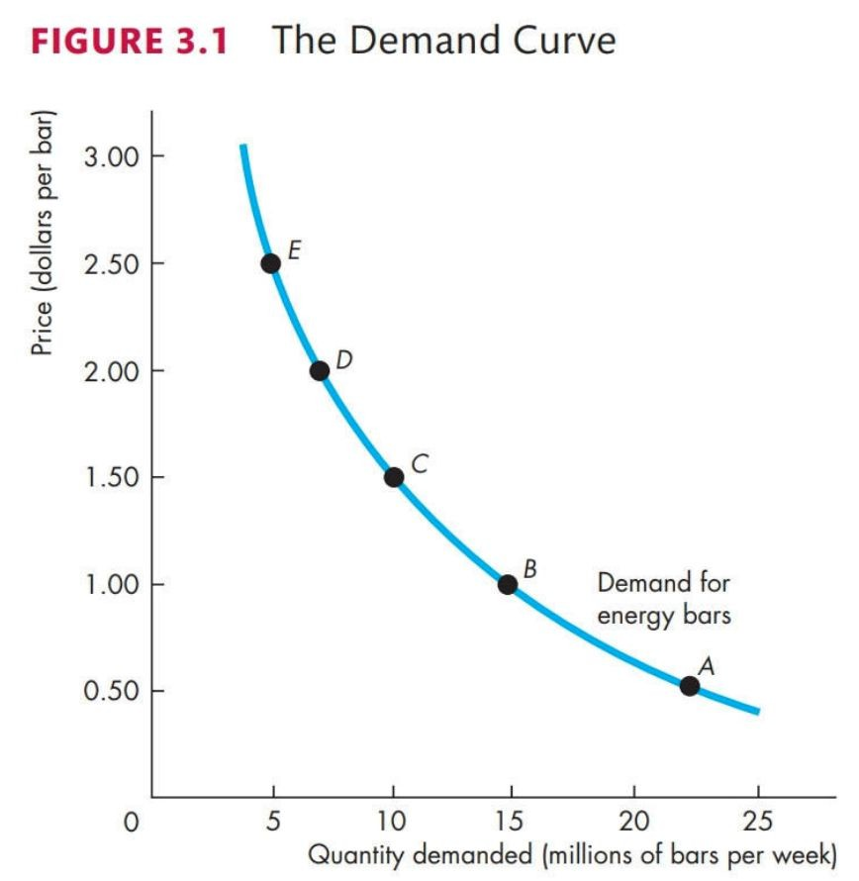
3. Demand & Supply - Demand
Demand: when a person wants something, can afford it, and plan on buying it
Quantity demanded (Qd): amount a person plans to buy at a specific price
Law of Demand: if price increases, Qd decreases
Shifts:
P of related goods (complementary or substitutes)
P expected in the future
Income
Future income
Population
Preference

Slide 12
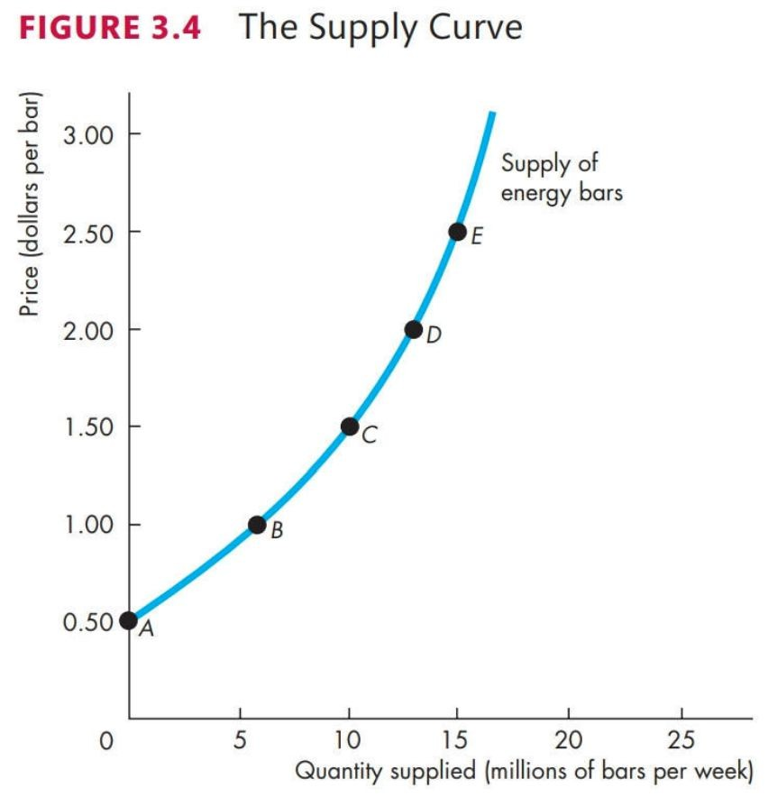
3. Demand & Supply - Supply
Supply: when a firm have the technology and resources to produce, can make profit from it, and plan on producing and selling
Quantity supplied (Qs): amount a firm would produce at a specific price
Law of Supply: if price increases, Qs increases
Shifts:
P of factors of production
P of related goods (complementary or substitutes)
P expected in the future
Number of suppliers
Technology
State of Nature

Slide 13
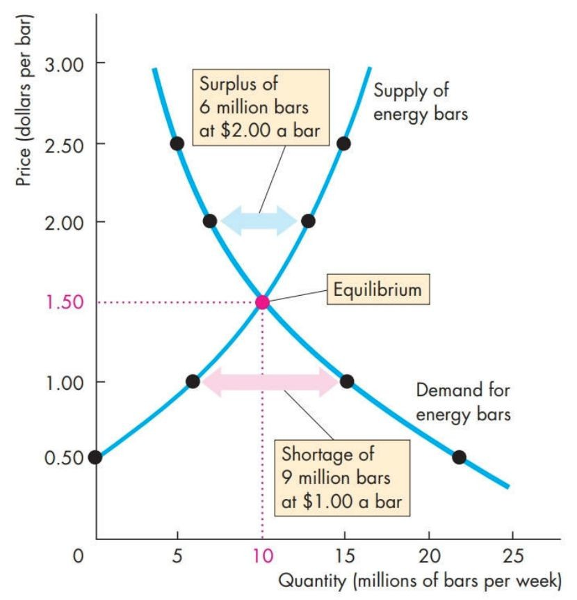
3. Demand & Supply - EQM
Market equilibrium: occurs when demand equals supply
Steps to Solving EQM:
Equate the demand and supply equations
Solve the system of equations
Pluck the solved P or Q back into either of the demand or supply functions to solve for the other unknown

Slide 14
3. Demand & Supply
Q5: The prices for hoodies in CMP Land rose, as a result…
the supply curve will shift right
the demand curve will shift left
Qs will decrease
The supply curve will shift left
Q6: Pen is a substitute of pencil, and eraser is complimentary to pencil. If the price for pencil increased, the demand for pen will , and the demand for eraser will .
increase, decrease
remain the same, remain the same
decrease, increase
decrease, remain the same

Slide 15
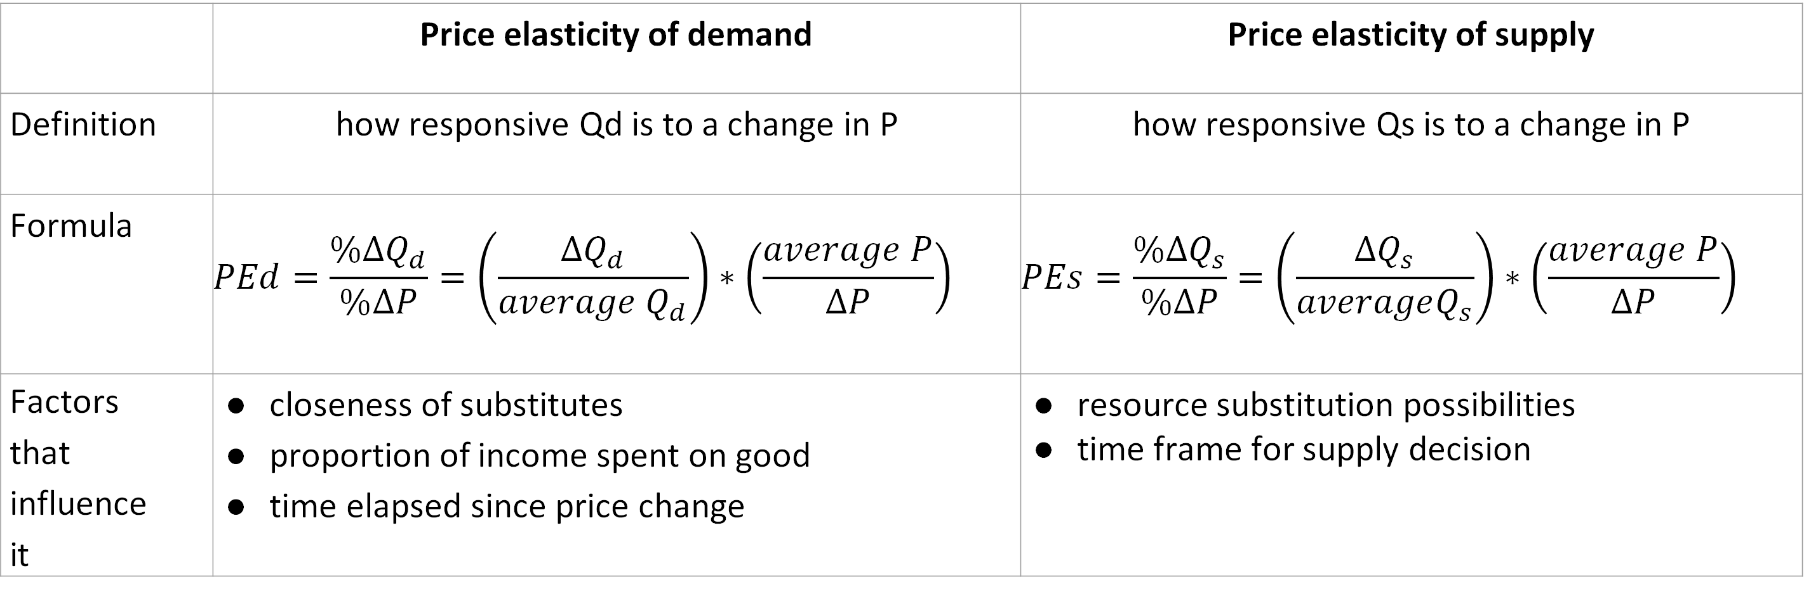
4. Elasticity - ed, es
 | Price elasticity of demand | Price elasticity of supply
Definition | how responsive Qd is to a change in P | how responsive Qs is to a change in P
Formula | $$PEd=\frac{\%∆Q_{d}}{\%∆P}=\left(\frac{∆Q_{d}}{average{ Q}_{d}}\right)∗\left(\frac{average P}{∆P}\right)$$ | $$PEs=\frac{\%∆Q_{s}}{\%∆P}=\left(\frac{∆Q_{s}}{averageQ_{s}}\right)∗\left(\frac{average P}{∆P}\right)$$
Factors that influence it | closeness of substitutes proportion of income spent on good time elapsed since price change | resource substitution possibilities time frame for supply decision

Slide 16
4. Elasticity - ed, es
Q7: Suppose the value of price elasticity of demand is -3. What does this mean?
A $1 increase in price causes the quantity demanded to fall by 3 units
A 3 percent increase in the price of a good causes quantity demanded to decrease by 1 percent
A 1 percent increase in the price of a good causes the quantity demanded to increase by 3 percent
A 1 percent increase in the price of a good causes the quantity demanded to decrease by 3 percent
What does that tell you about elasticity?

Slide 17
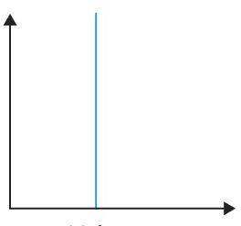
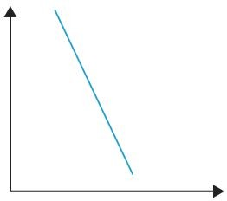
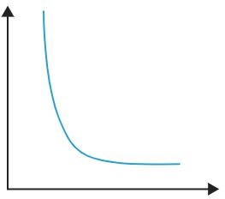
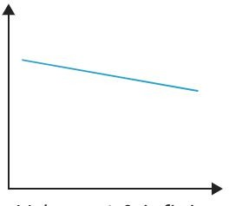
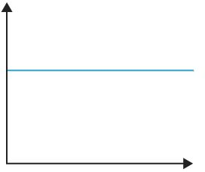
4. Elasticity - 5 Types of Ed
 | perfectly inelastic | inelastic | unit elastic | elastic | perfectly elastic
Definition | Qd stays the same regardless of P | Qd reacts little to P changes | Qd changes in the same proportion as the change in P | Qd reacts alot to P changes | Qd changes by an infinitely large amount when P changes
ed range | ed = 0 | ed < |1| | ed = |1| | ed > |1| | ed = |∞|
graph
examples | insulin | food shelter |  | cars furnitures | 2 soft drinks side-by-side in a vending machine

Slide 18
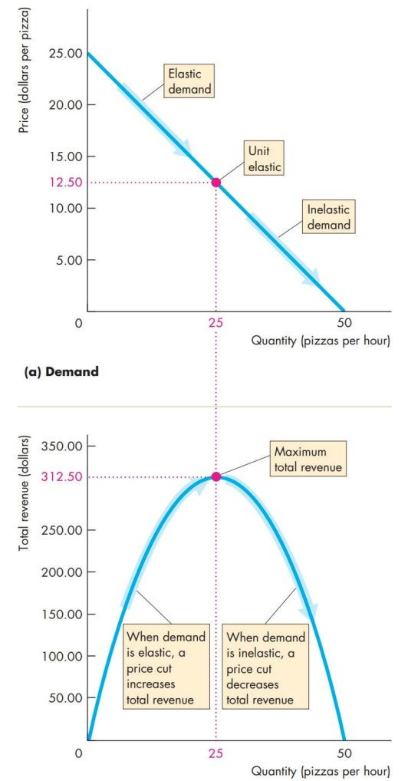
4. Elasticity - Total Revenue (TR)
ed = elastic
upper half of a linear demand curve
decrease price to maximize TR
ed = inelastic
lower half of a linear demand curve
increase price to maximize TR
ed = unit elastic
midpoint of a linear demand curve
maximizes TR

Slide 19
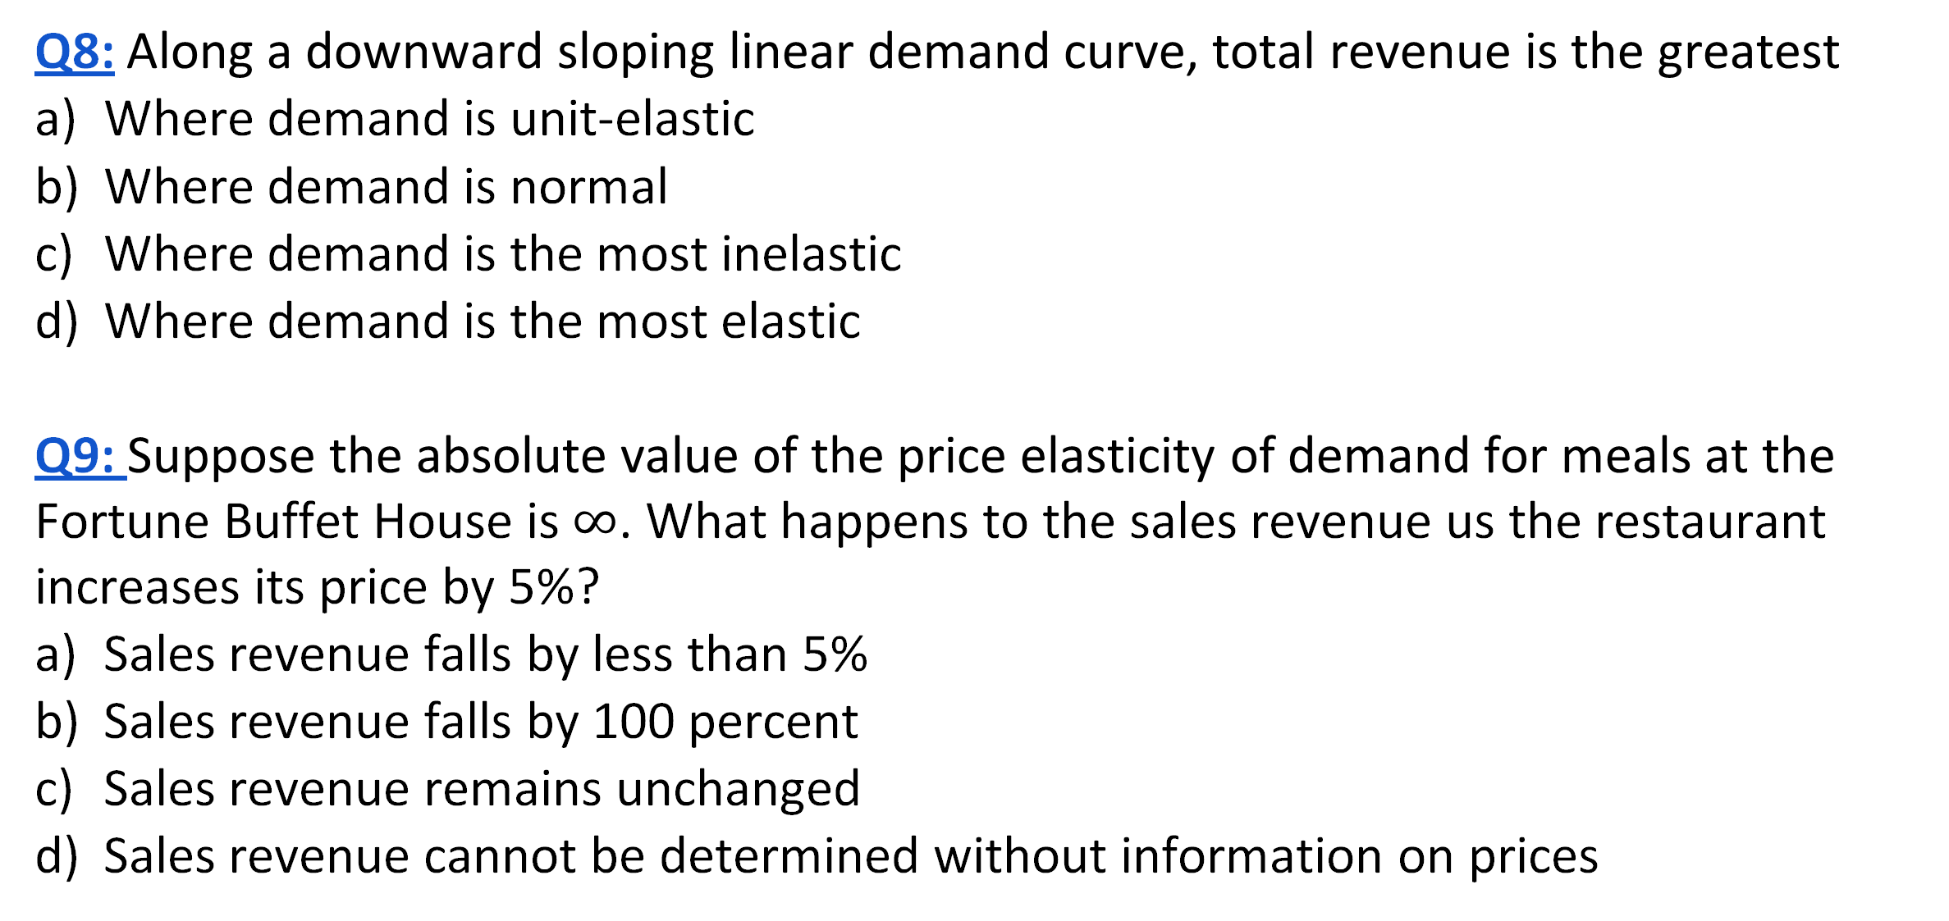
4. Elasticity - Total Revenue (TR)
Q8: Along a downward sloping linear demand curve, total revenue is the greatest
Where demand is unit-elastic
Where demand is normal
Where demand is the most inelastic
Where demand is the most elastic
Q9: Suppose the absolute value of the price elasticity of demand for meals at the Fortune Buffet House is $∞$. What happens to the sales revenue us the restaurant increases its price by 5%?
Sales revenue falls by less than 5%
Sales revenue falls by 100 percent
Sales revenue remains unchanged
Sales revenue cannot be determined without information on prices

Slide 20
4. Elasticity - More Elasticity
cross elasticity: how responsive demand for a good is when P changes substitute or complement
ec = % Δ Qd
% Δ Psub/complement
ec < 0 → complement good: it’s used with the good
ec > 0 → substitute good: it can be used to replace the good
income elasticity: how responsive demand for a good is when income changes
ei = % Δ Qd
% Δ income
ei ≥ 1 → income elastic, normal good: demand for it rises when income rises
0 < ei < 1 → income inelastic, normal good
ei < 0 → depends, inferior good: demand for it drops when income rises

Slide 21
4. Elasticity
Q10: Consider the following data for a hypothetical economy.
The income elasticity of demand for gasoline is
0.5
6.0
8.3
1.2
Year | Average Household Income ($) | Price of gasoline ($/litre) | Quantity demanded of gasoline (mil litres)
2021 | 78000 | 1.3 | 1940
2022 | 82000 | 1.3 | 2060

Slide 22
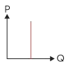
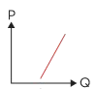
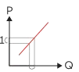
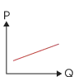
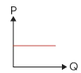
4. Elasticity - 5 Types of Es
 | perfectly inelastic | inelastic | unit elastic | elastic | perfectly elastic
Definition | Qs stays the same regardless of P | Qs reacts little to P changes | when a linear supply curve passes through the origin | Qs reacts alot to P changes | Qhen the supplier is willing to sell any quantity at a specific P
es range | es = 0 | es < |1| | es = |1| | es > |1| | es = ∞
graph
examples | Van Gogh painting |  |  |  | goods that are produced in many countries

Slide 23
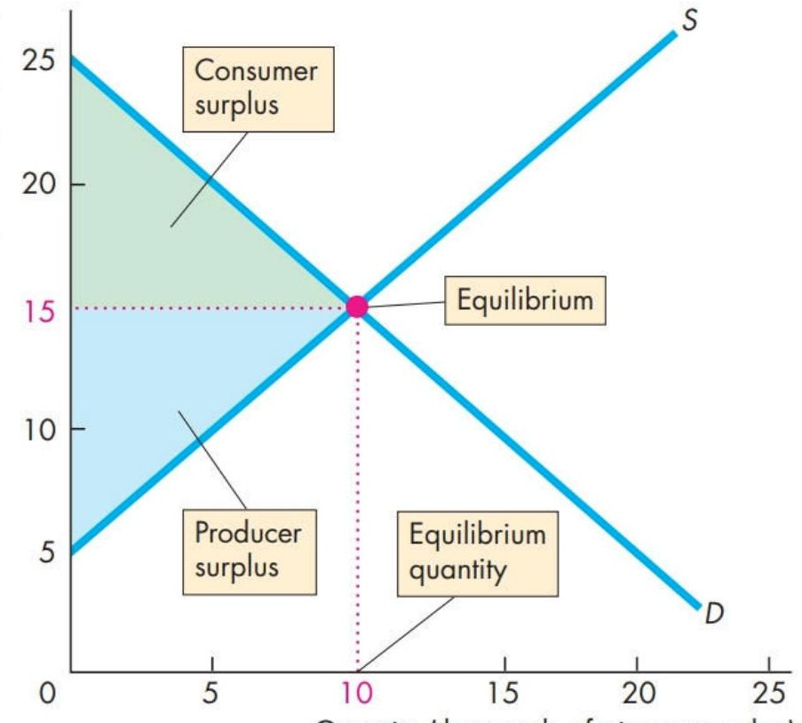
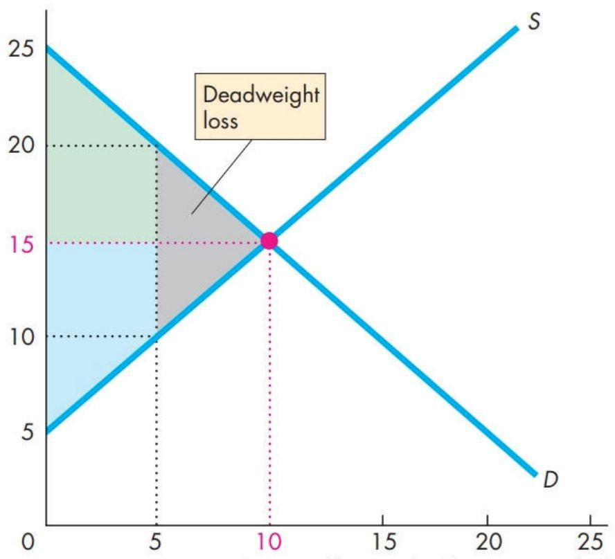
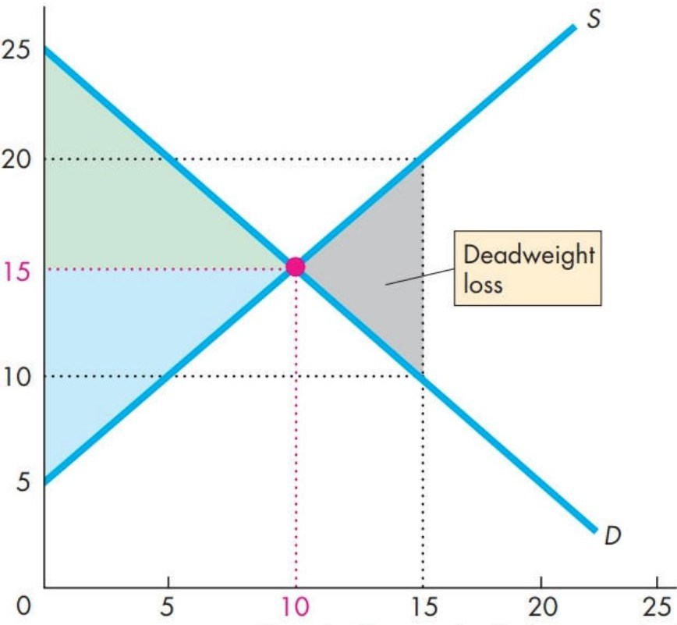
5. Surplus & Efficiency
consumer surplus (CS): excess $ saved
what you’re willing to pay > what you actually pay
producer surplus (PS): excess $ received
what you actually receive > what you expected
when not at EQM:
inefficient
deadweight loss (DWL): amount of lost surplus

Slide 24
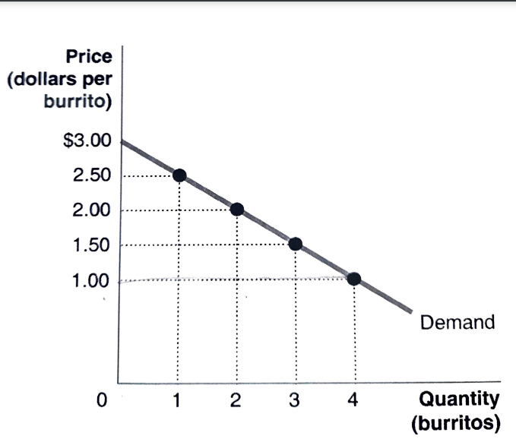
5. Surplus & Efficiency
Q11: the figure shows Arnold’s demand curve for burritos.
If the market price is $1.00, what is Arnold’s consumer surplus?
$1.00
$2.00
$4.00
$7.00

Slide 25
We hope you have been enjoying the review session so for! When you hove a chance, please Bill out our survey. We appreciate your feedback.

Slide 26
6. Government Actions in Market - Regulations on the Price
 | Price Ceiling | Price Floor
Definition | when it’s illegal to charge above a certain price | when it’s illegal to charge below a certain price
Goal | Decrease price | Increase price
How? | Price ceiling < P* | Price floor > P*
Market Failure | underproduction | underproduction
Consequence | D > S → shortages | S > D → surplus
Eg. | Rent market | Labour market

Slide 27
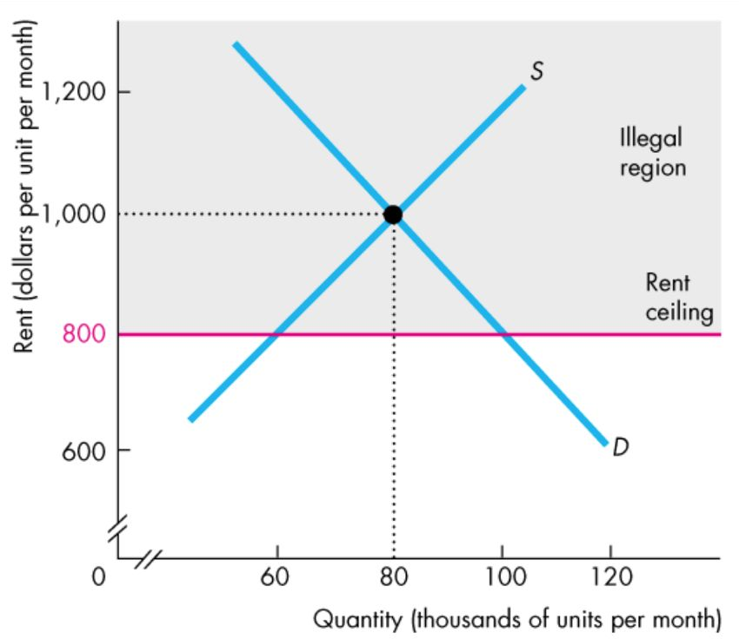
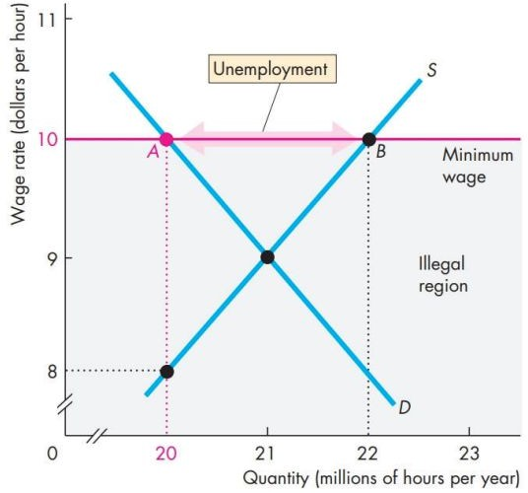
6. Government Actions in Market - Regulations on the Price
Price Ceiling | Price Floor

Slide 28
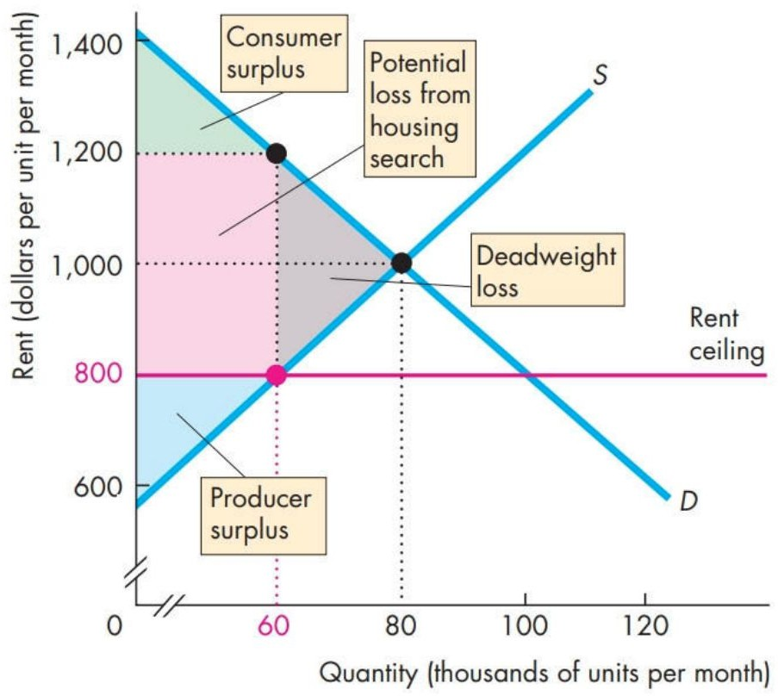
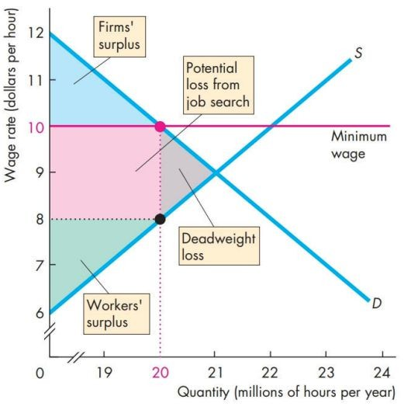
6. Government Actions in Market - Regulations on the Price
Price Ceiling | Price Floor

Slide 29
6. Government Actions in Market - Price Ceiling
Q12: A low-income country decides to set a price ceiling on bread so it can make sure that bread is affordable to the poor. Table provides the conditions of demand and supply. What are the equilibrium price and equilibrium quantity before the price ceiling? What will the excess demand or the shortage (that is, quantity demanded minus quantity supplied) be if the price ceiling is set at $2.40?
Price ($) | Qd | Qs
1.60 | 9000 | 5000
2.00 | 8500 | 5500
2.40 | 8000 | 6400
2.80 | 7500 | 7500
3.20 | 7000 | 9000
3.60 | 6500 | 11000

Slide 30
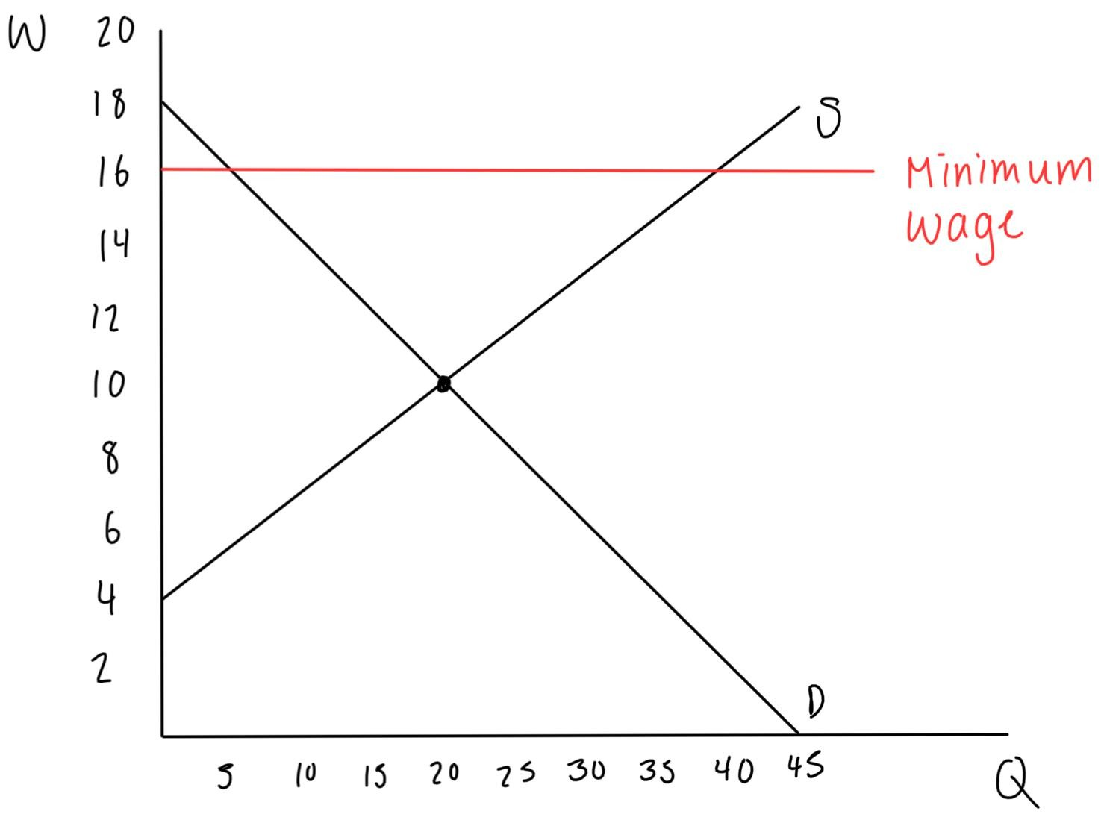
7. Government Actions in Market - Price Floor
The demand function in a labour market is W = -0.4Qd + 18, and the supply function is W = 0.3Qs + 4. If the government implements a minimum wage of $16/hr, answer the following questions:
Q13: Who’s the supplier and who’s the consumer of the labour market?
Q14: Calculate the CS, PS, and DWL.

Slide 31
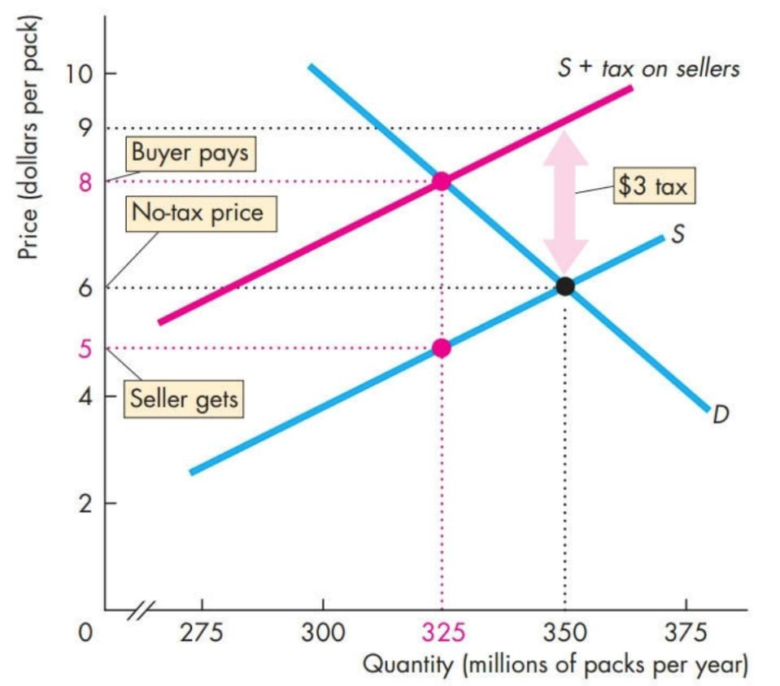
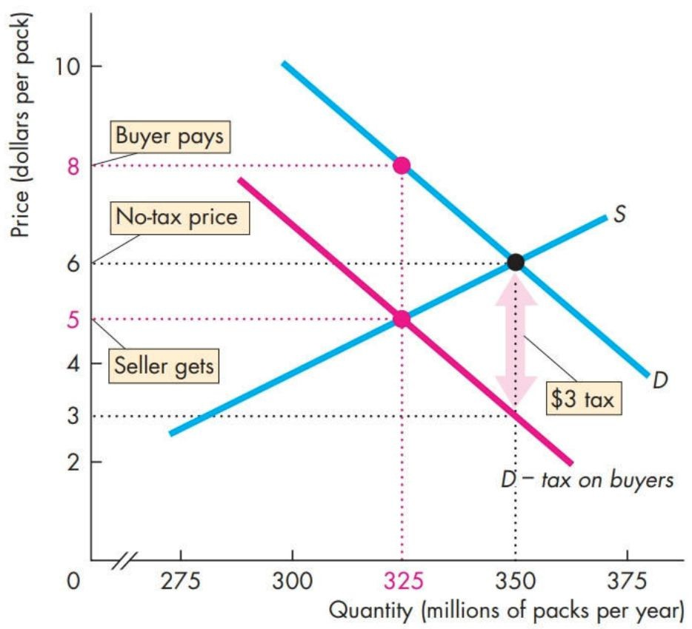
7. Government Actions in Market - Taxes
Tax incidence: division of the burden of a tax between the seller and buyer
increases P, decreases Q
If taxes are imposed on the seller…
costs rise > supply curve shifts to S + tax on sellers
If taxes are imposed on the buyer
the amount the buyer is willing to pay the seller decreases > demand curve shifts to D – tax on buyers
No matter who the taxes are imposed on, the result is the same

Slide 32
7. Government Actions in Market - Taxes

Slide 33
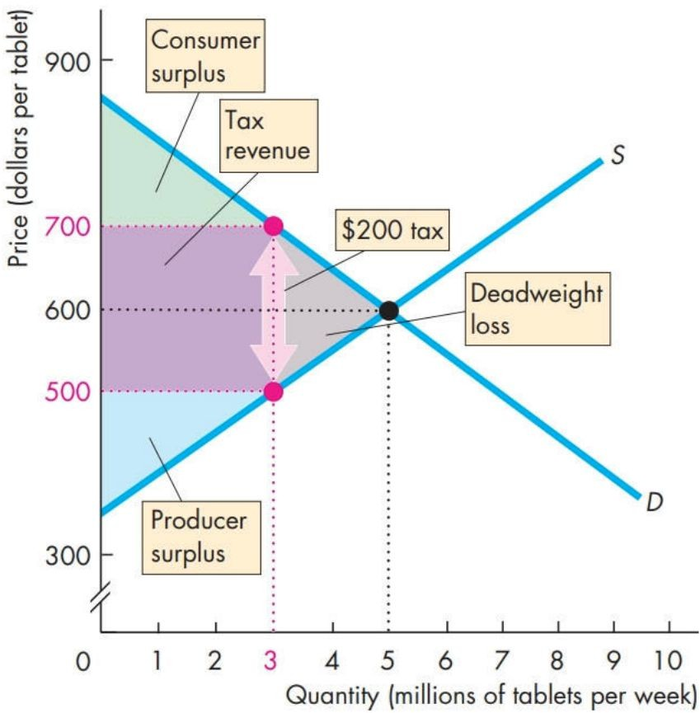
7. Government Actions in Market - Taxes
S + tax on sellers

Slide 34
7. Government Actions in Market - Taxes
The more inelastic ed is, the higher the buyer’s share of taxes
The more inelastic es is, the higher the seller’s share of taxes

Slide 35
7. Government Actions in Market - Taxes, Production Quota, Subsidy
Q15: Goods like alcohol, cigarette and gas typically have inelastic demand. If a tax is imposed on them, who would pay more of the tax?
buyer
seller
both will pay equal share
government
Q16: Why do we add the tax amount to the supply function, but subtract the tax amount from the demand function?

Slide 36
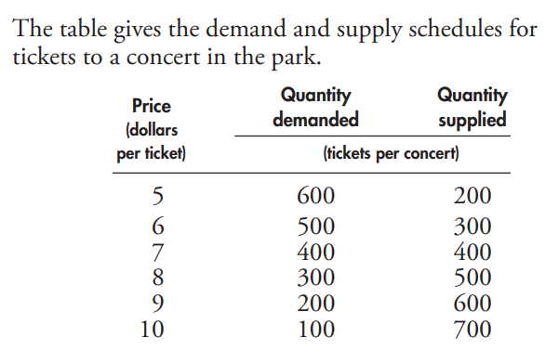
7. Government Actions in Market - Taxes, Production Quota, Subsidy
Q17: The table gives the demand and supply schedules for tickets to a concert in the park.
If there is no tax on concert tickets, what is the price of a ticket and how many tickets are bought?

Slide 37
7. Government Actions in Market - Taxes, Production Quota, Subsidy
Q17:
(contd) If a sales tax of $2 a ticket is levied on sellers of concert tickets: What is the price a concert-goer pays for a ticket and how many tickets are bought?

Slide 38
7. Government Actions in Market - Taxes, Production Quota, Subsidy
Q17:
Who pays the tax and what is the government’s tax revenue?
Is the market for concert tickets efficient?

Slide 39
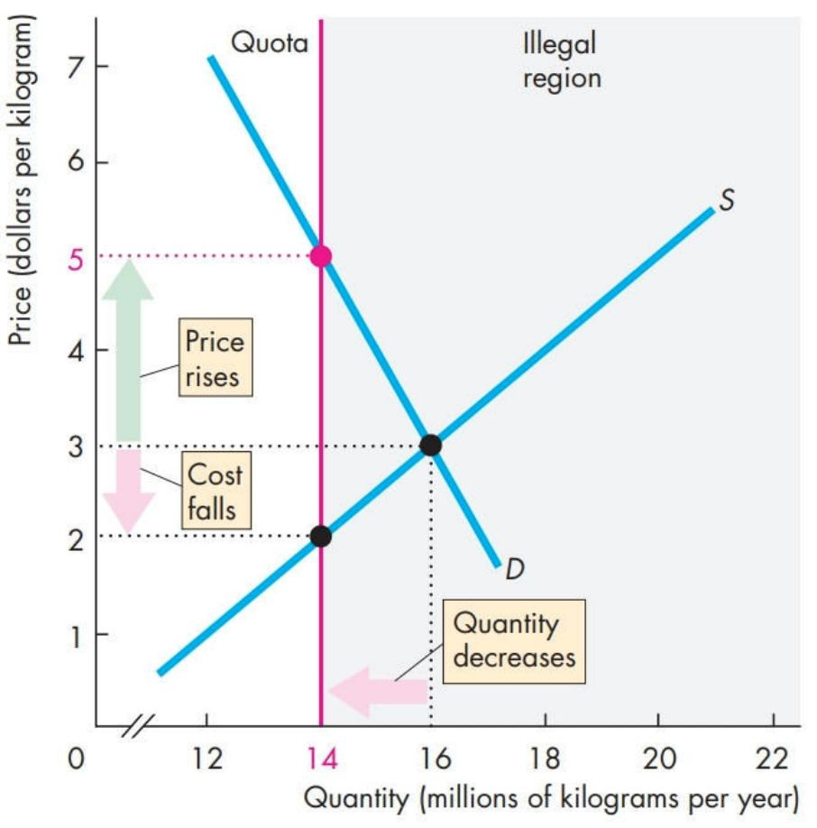
7. Government Actions in Market - Production Quota
production quota: limits how much can be produced
underproduction
increases P, decreases Q
eg. cigarette market
effective only when the production quota < Q*

Slide 40
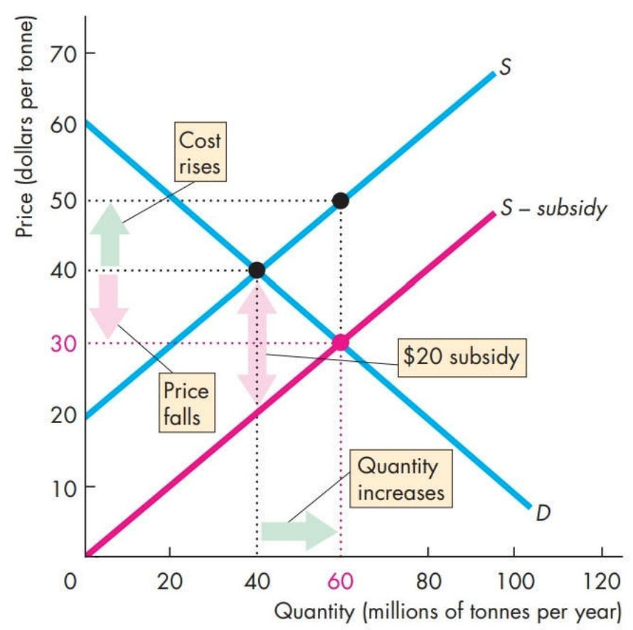
7. Government Actions in Market - Subsidy
subsidy: when the government encourages production by sponsoring the producers
decreases P, increases Q
overproduction
costs decrease > supply curve shifts to S – subsidy
like a “negative tax”
producers receive more money than before

Slide 41
7. Government Actions in Market - Subsidy
Q18: Are producers better off as a result of a subsidy? Why or why not? (Hint: Compare how much money they receive before and after the subsidy)

Slide 42
Thank You
Any questions?

Slide 43
8. Output & Costs
short run (SR): time frame where the quantities of 1 or more resources used in production is fixed
eg. plant is fixed in SR, but other resources (labour, raw material) can change
decisions are reversible
long run (LR): time frame where the quantities of all resources used in production can vary
decisions are irreversible
sunk cost: cost that incurred and can’t be changed, so it’s irrelevant to a firm’s decision-making process
eg. plant with no resale value, its cost is a sunk cost

Slide 44
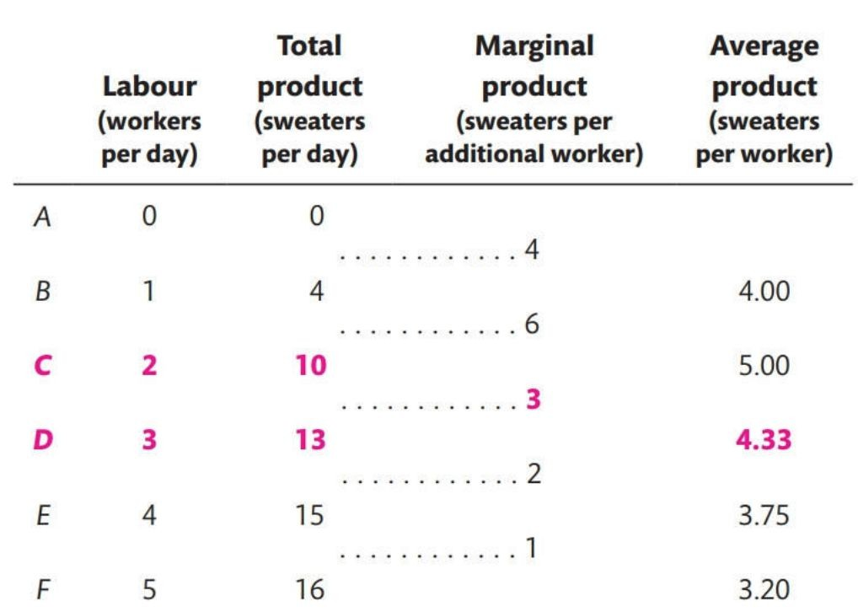
8. Output & Costs - SR Product Curves
since other inputs are fixed in the SR, can only increase labour to increase output
Product Curves
total product (TP): how much output is produced in total
marginal product (MP): how much output changes when there’s 1 additional unit of labour
average product (AP): TP
# units of labour

Slide 45
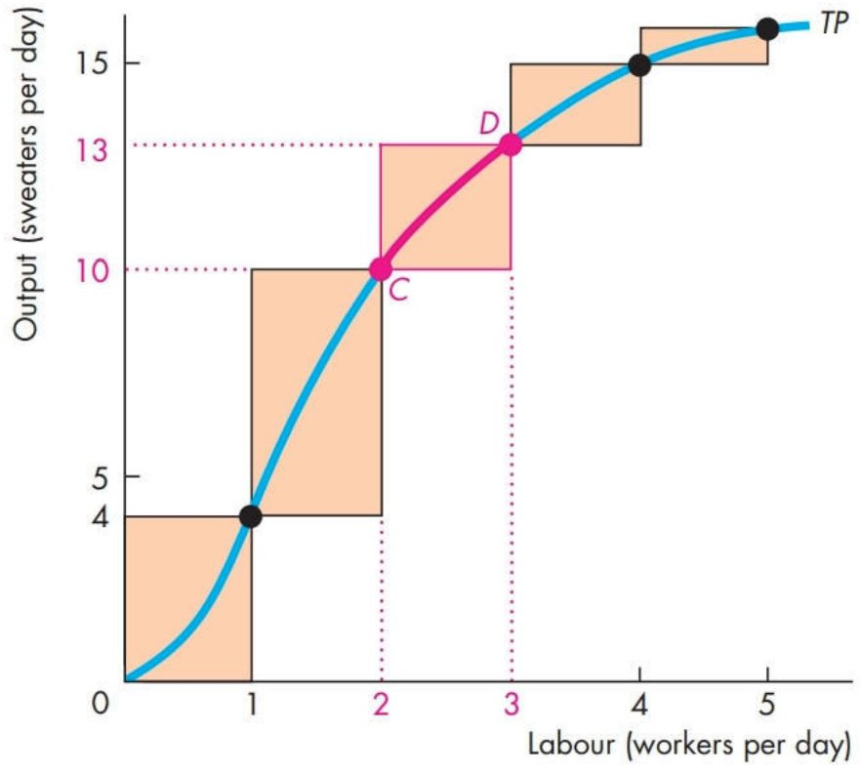
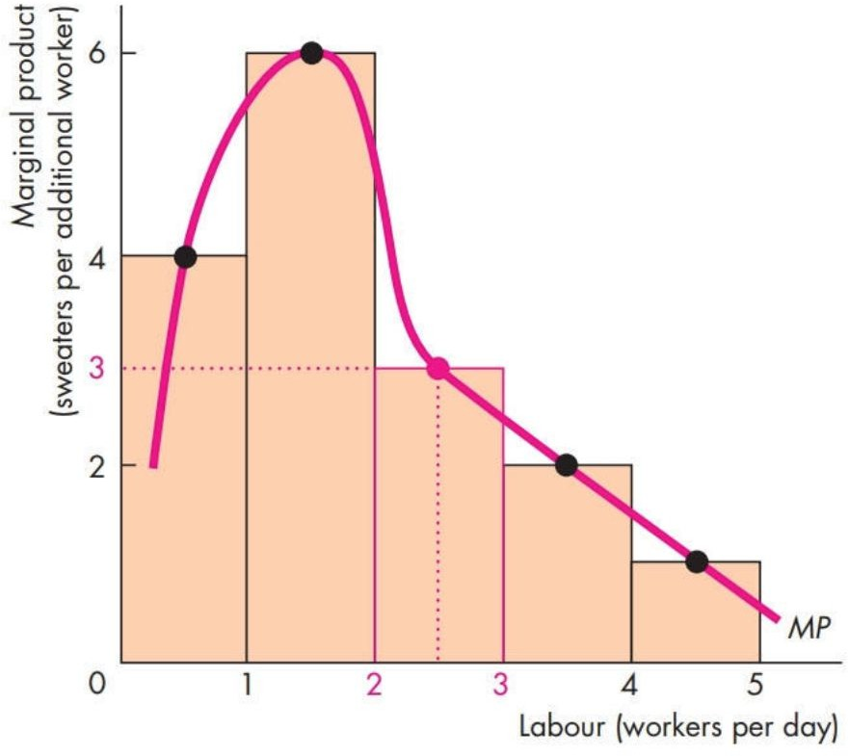
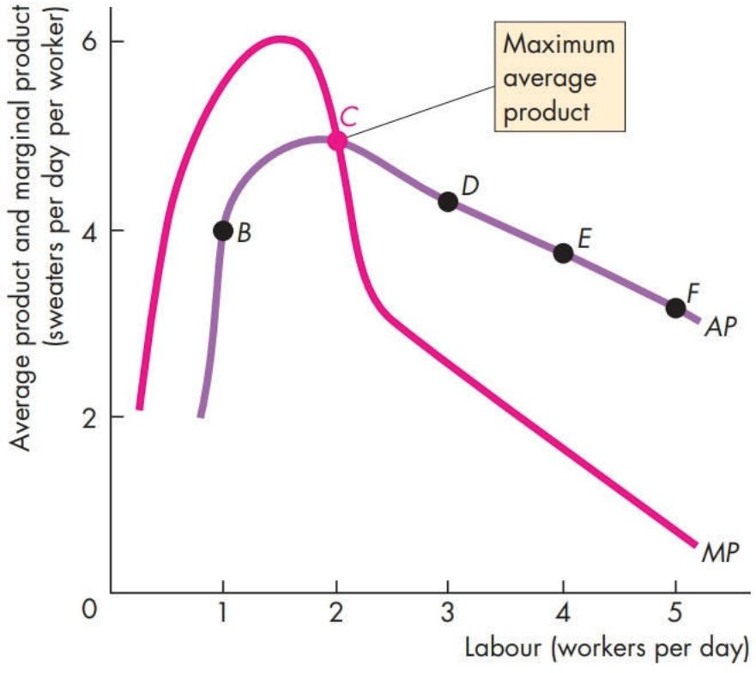
8. Output & Costs - TC, TFC, TVC Curves
TP | MP | AP
TP originally increases quickly, but it eventually slows down | increasing marginal returns: MP of the next worker > MP of the previous decreasing marginal returns: MP of the next worker < MP of the previous law of diminishing returns: MP eventually decreases as we use more variable input with fixed input | when MP > AP → AP increases when MP < AP → AP decreases when MP = AP → AP is at maximum

Slide 46
8. Output & Costs
Q21: In the short run, can vary:
number or size of machines
number of factories
number of workers
none of the above
Q22: Decreasing marginal returns occurs at:
output level of zero
high levels of output
low levels of output
when MP > AP

Slide 47
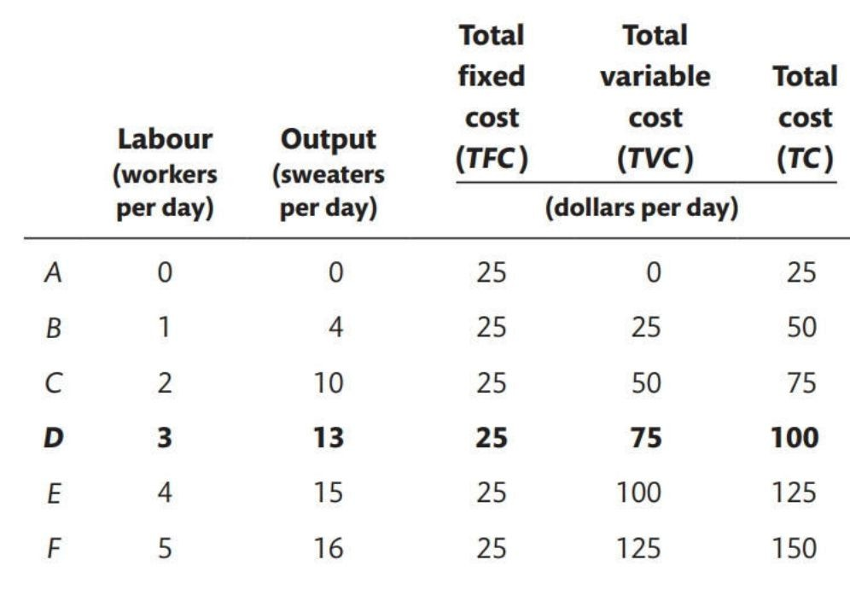
8. Output & Costs - SR Cost Curves
increasing labour increases costs
7 Cost curves
Total Cost (TC): All costs
Total Fixed Cost (TVC): cost of fixed inputs, FC is fixed
Total Variable Cost (TVC): cost of variable inputs, VC changes when output changes
TC = TFC + TVC
Average Total Cost (ATC): TC/ Q
Average Total Fixed Cost (AFC): TFC/ Q
Average Total Variable Cost (AVC): TVC/ Q
ATC = AFC + AVC
Marginal Cost (MC): increase in TC when TP increases by 1

Slide 48
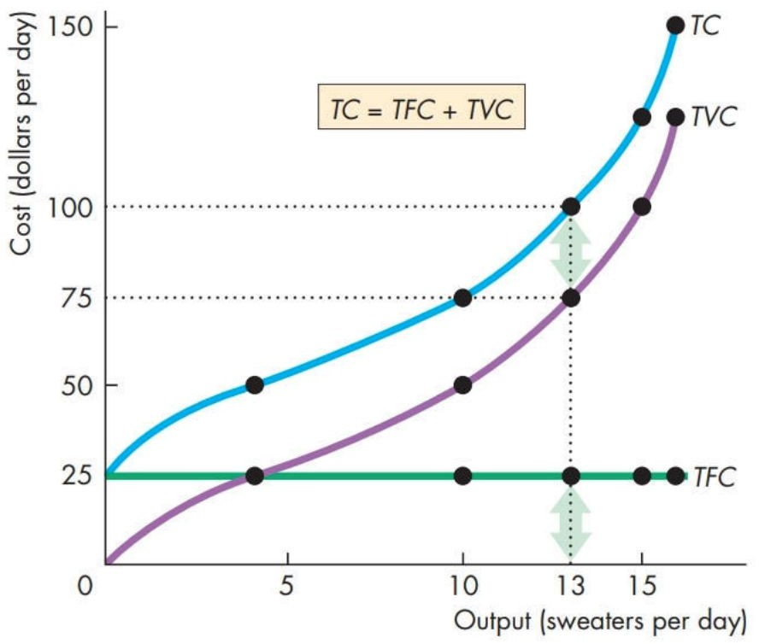
8. Output & Costs - TC, TFC, TVC Curves
TFC | TVC | TC
horizontal, straight line constant because fixed input is fixed | at low levels of output, TVC is flat because MC are decreasing at high levels of output, TVC is steep because MC are increasing | simply a TVC curve that’s shifted up the distance between TC and TVC is TFV

Slide 49
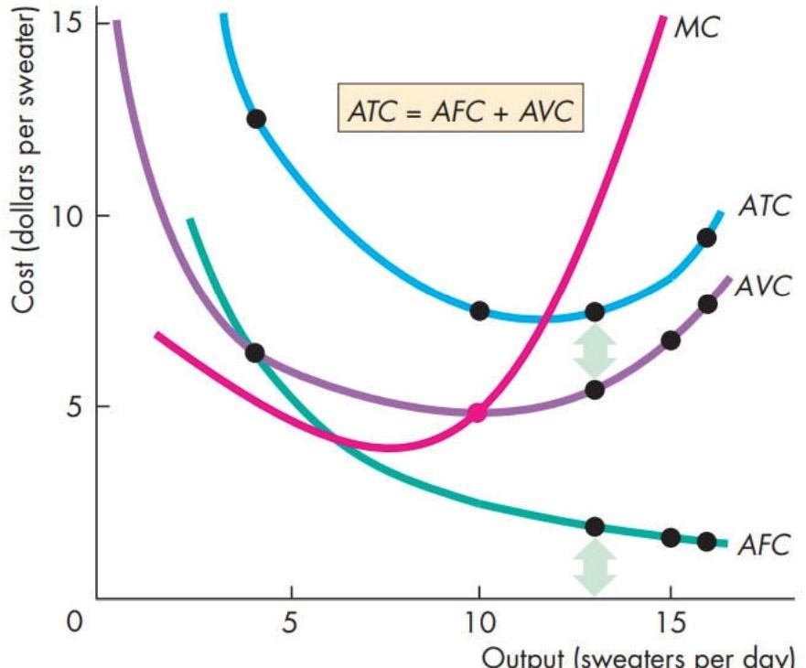
8. Output & Costs - ATC, AFC, AVC, MC Curves
AFC | AVC | ATC | MC
decreases as output increases | U-shaped | U-shaped distance between ATC & AVC is AFC, and it shortens because ATC is decreasing | decreases until a certain point before it begins increasing
MC is below AVC/ATC → AVC/ATC is decreasing
MC is above AVC/ATC → AVC/ATC is increasing
MC = AVC/ATC → AVC/ATC is at minimum

Slide 50
8. Output & Costs - Cost Curves
Q23: When MC = AVC,
AVC is at maximum
AVC is at minimum
ATC is at maximum
ATC is at minimum

Slide 51
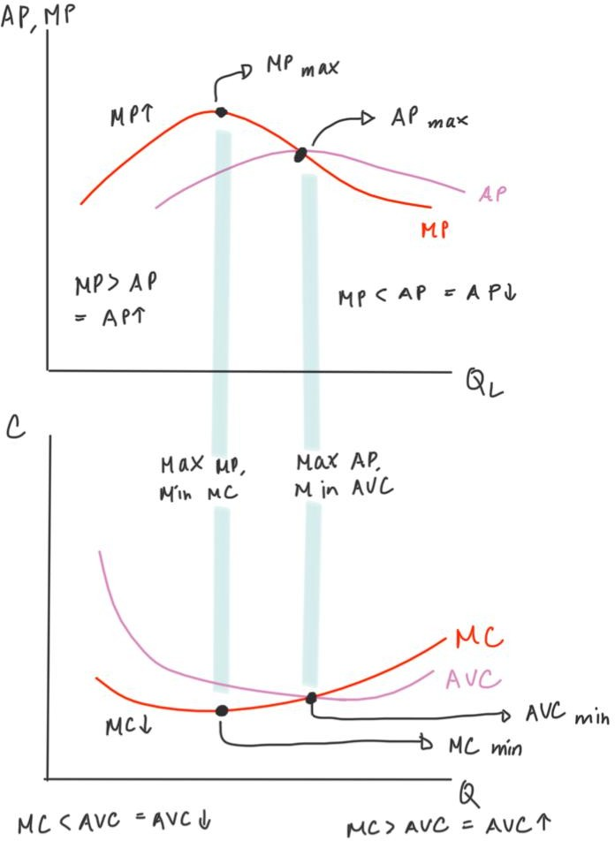
8. Output & Costs - MP/AP vs. MC/AC Curves
MP is at max → MC is at min
AP is at max → AVC is at min

Slide 52
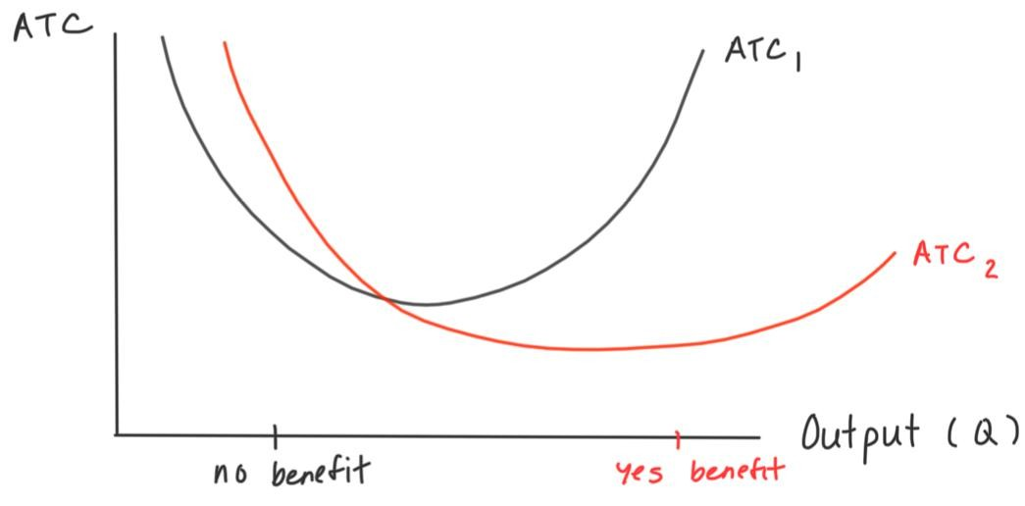
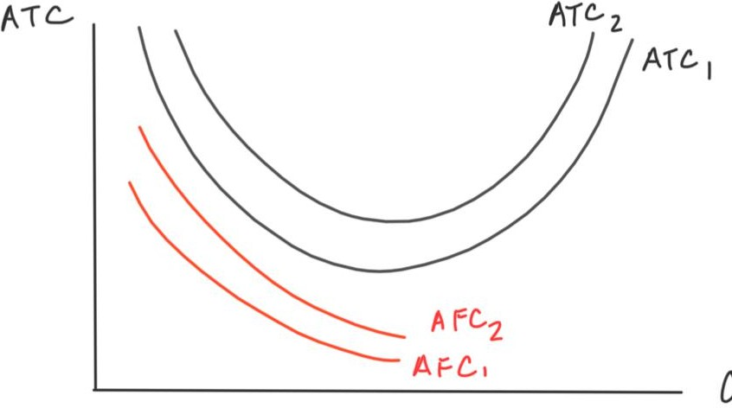
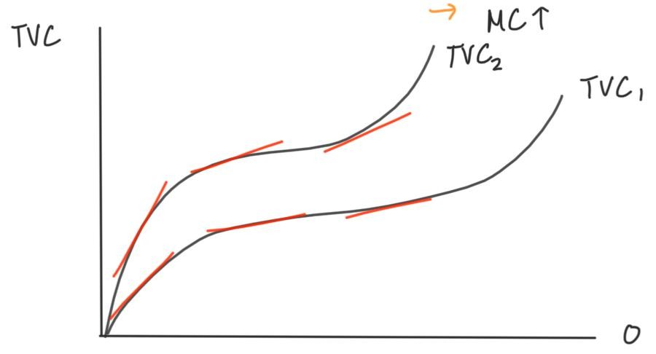
8. Output & Costs - Shifts in Cost Curves
Technological Advances | Price of Fixed Factors | Price of Variable Factors
capital cost rises > AFC rises but AVC drops at low level of output, ATC is high at high level of output, ATC is low | price of fixed factors rises > TFC rises > AFC rises > ATC rises TVC, AVC, MC = same | price of variable factors rises > TVC rises > AVC rises > ATC rises steeper tangents means higher MC

Slide 53
8. Output & Costs - Cost Curves
Q24: When MP is rising,
AP is at maximum
MP < AP
MC is decreasing
AVC is rising
Q25: When a technology change that improves productivity occurs, which is FALSE?
AFC increases but AVC decreases
capital costs rises
It’s more beneficial to produce high output levels because ATC is lower there
It’s more beneficial to produce low output levels because ATC is lower there

Slide 54
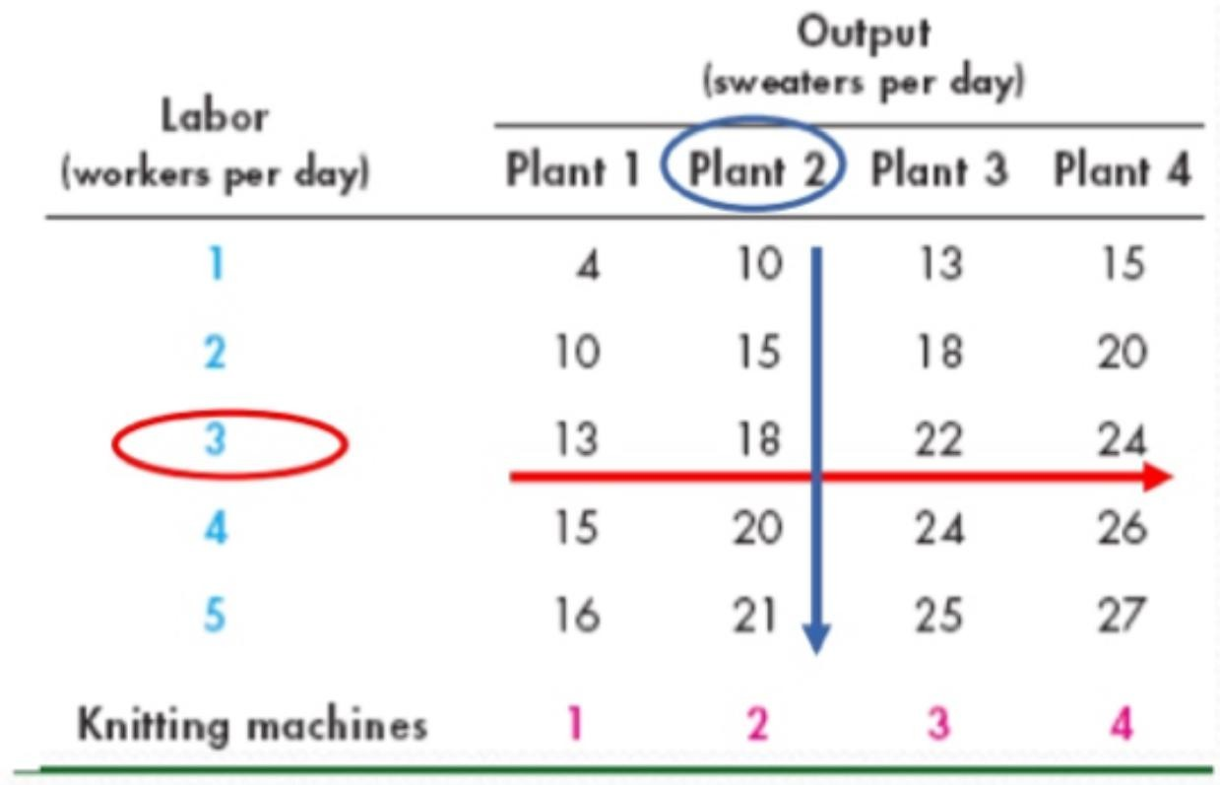
8. Output & Costs - LR
all inputs and all costs are variable
marginal product of capital: the increase in output when capital increases by 1 unit (labour constant)
Diminishing marginal returns to capital: MP increases quickly at first, but it eventually slows down as we keep increasing the plant size
each plant has their own cost curve

Slide 55
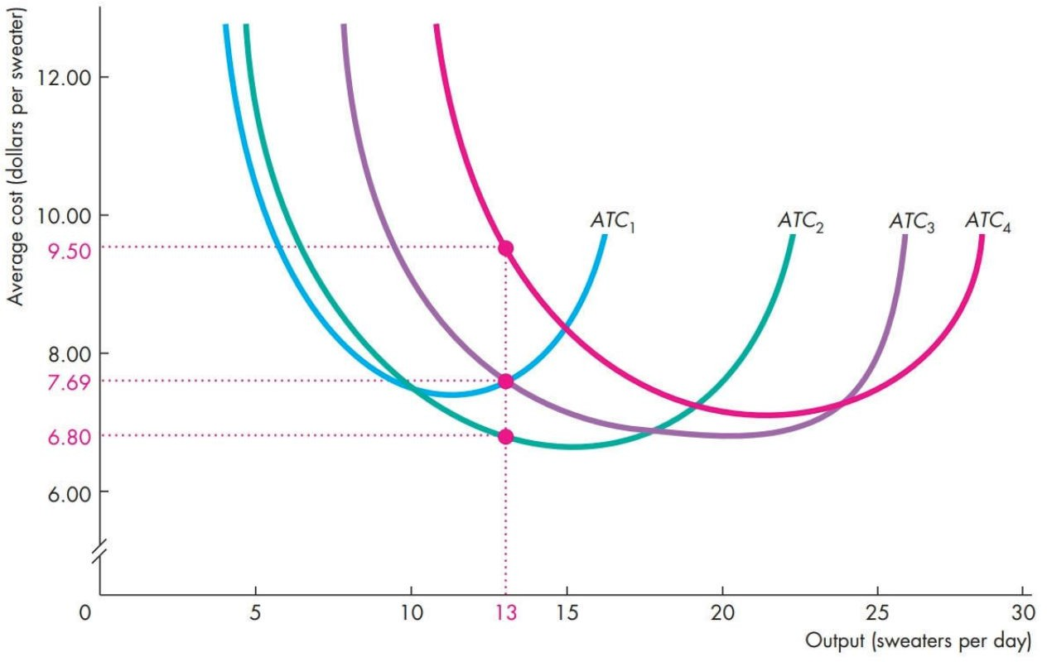
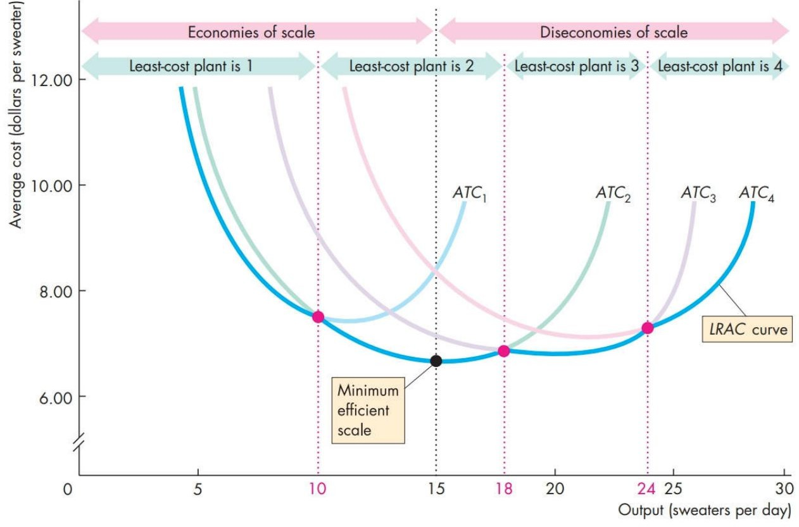
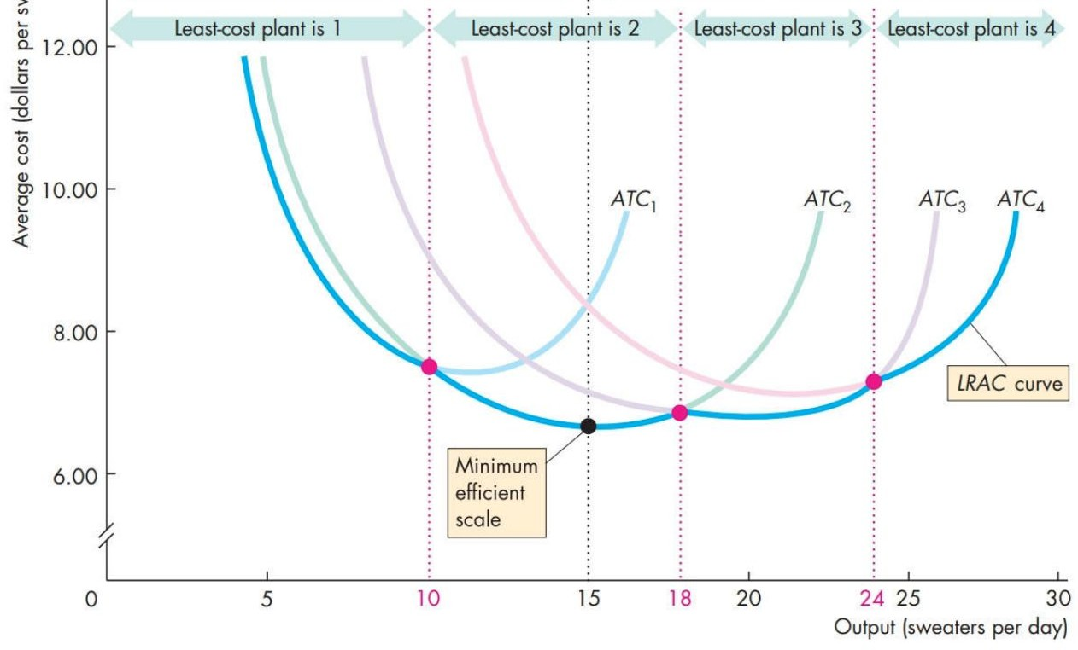
8. Output & Costs - LRAC
Long run average cost (LRAC) curve: made up of the lowest ATC for each output level
economies of scale: ATC decreases as output increases
diseconomies of scale: ATC increases as output increases
constant returns to scale: ATC is the same as output increases
minimum efficient scale: lowest point on the LRAC curve

Slide 56
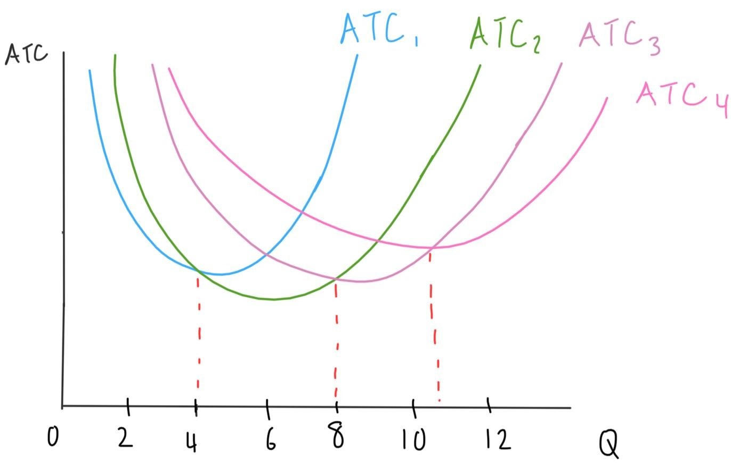
8. Output & Costs - Cost Curves
Q26: At an output level of 10 units, which plant would achieve the lowest ATC?
Plant 1
Plant 2
Plant 3
Plant 4
Q27: At the output level of 6, there is,
economies of scale
diseconomies of scale
constant economies of scale
minimum efficient scale

Slide 57


9. Utility & Demand - Consumption Possibilities
consumption possibilities: all of the things that you can buy
limited by income and prices of the goods/services
budget line: shows the boundary between the combinations of goods/services that a household can and can’t afford to buy
changes when income or prices change

Slide 58


9. Utility & Demand - Utility
preferences: consumer’s likes and dislikes
utility: benefit or satisfaction a person gets from consuming goods/services
Total Utility (TU) | Marginal Utility (MU)
increases as consumption increases at levels of consumption, TU increases by less each time | how much TU changes when 1 more unit of a good is consumed diminishing marginal utility: MP decreases as consumption increases

Slide 59

9. Utility & Demand - Utility-Maximizing Choice
Steps:
Find the Just-Affordable Combinations (shown by the consumer’s budget line)
Find the TU for each Just-Affordable Combination
Find the consumer EQM
consumer EQM: when the consumer allocated their income in a way that maximizes their total utility
marginal utility per dollar: how much TU increases when I spend 1 more dollar on the good/service
MU of the good/ Price of the good
utility is maximized when
all income is spent
MU = MU
1 2
P₁ P₂

Slide 60
9. Utility & Demand - Utility-Maximizing Choice
Q28: Given the table, fill in the the column, MUy/$. Which combination of bubble tea and yogurt maximizes utility and how do you know?
 | Bubble Tea ($10) |  |  | Yoghurt ($4)
 | Qb | MUb | MUb/$ | Qy | MUy | MUy/$
A | 1 | 70 | 7 | 6 | 2
B | 2 | 40 | 4 | 5 | 6
C | 3 | 20 | 2 | 4 | 8

Slide 61
9. Utility & Demand - Real Income, Relative Price
real income: income expressed as a quantity of goods that the household can afford to buy
real income = Y/P of a good
eg. if income is $50 and a granola bar is $2, the real income in terms of granola bars is 25 granola bars
relative price: price of good 1/ price of good 2
eg. If a movie ticket is $8 and a granola bar is $2, the relative price of a granola bar is 4 movie tickets

Slide 62


9. Utility & Demand - Changes to the Budget Line
Changes in Prices | Changes in Income
Price changes > relative price changes > slope changes Price of the good on the x-axis drops → budget line flattens Price of the good on the x-axis rises → budget line gets steeper | Income changes > real income changes > budget line shifts income increases → budget line shifts right income decreases → budget line shifts left

Slide 63


9. Utility & Demand - Preferences and Indifference Curves
Indifference Curve | Preference Map
shows the combos of goods where the consumer is indifferent order of preference: below indifference curve, indifference curve, above indifference curve | shows multiple indifference curves farther the budget line is from the origin, the more the consumer prefers it

Slide 64

9. Utility & Demand - Marginal Rate of Substitution
marginal rate of substitution (MRS): rate at which a person is willing to give up good y to get an additional unit of good x, while remaining indifferent
steep indifference curve → MRS = high
flat indifference curve → MRS = low
diminishing marginal rate of substitution: as the consumer gets more of good x, they will be less willing to give up good y for it while staying indifferent

Slide 65
9. Utility & Demand - Changes to the Budget Line
Q29: Consider a graph with budget line where the quantity of bubble tea is on the y-axis and the quantity of yoghurt is on the x-axis. If the consumer’s income decreased, the budget line (‘s) would .
N/A, shift to the right
N/A, shift to the left
slope, flatten
slope, become steeper
Q30: Where on the indifference curve would you expect a high MRS?
when the quantity of the good on the y-axis is 0
In the middle of the indifference curve
on the steeper side of indifference curve
when the quantity of the good on the x-axis is very high

Slide 66



9. Utility & Demand - Degree of Substitutability
degree of substitutability: affects the shape of the indifference curve
Ordinary Goods | Perfect Substitutes | Complements
goods that can substitute each other to a certain degree eg. movie and coke | goods that can very easily substitute for each other eg. pens from Superstore and pens from Walmart | goods that complement each other, can’t replace each other at all eg. left and right sneakers

Slide 67

9. Utility & Demand - Best Affordable Choice
Characteristics of the best affordable choice:
On the budget line (spent all of their income)
On the highest attainable indifference curve
MRS = the relative price of the 2 goods

Slide 68

9. Utility & Demand - Price Effect
Price Effect: when a change in the price of a good affects the quantity of the good consumed
Price changes > relative price changes > slope changes > best affordable choice changes
Explains why the demand curve is downward sloping

Slide 69

9. Utility & Demand - Income Effect
Income Effect: when a change in income changes the quantity of the good consumed
Income changes > real income changes > budget line shifts > best affordable choice changes > demand changes
as income decreases, the consumer buys less of both goods
Explains demand curve shifts

Slide 70

9. Utility & Demand - Price & Income Effect, Best Affordable Choice
Q31: The price effect explains the of the demand curve, while the income effect explains the of the demand curve.
vertical intercept, horizontal intercept
curviness, the vertical intercept
slope, shifts
Q32: Looking at the diagram on the right, where is the best affordable choice?
Point 1
Point 2
Point 3
Point 4

Slide 71
We hope you have been enjoying the review session so for! When you hove a chance, please Bill out our survey. We appreciate your feedback.

Slide 72



Focabook
Are you lookine *•• •n internship this summer or in the near future? Come to CMP's INTERNSHIP
NIGHT (November 24, 2022) to heor about upper yeor students' internship experiences!
They’ eive you oil of their best tips and intel, ocd they'll answer any questions you have you •
_{e}ht
hove for them. Free dinner oncl snacks will be provided! Follow us on lnstogrom ond Facebook for

Slide 73
6. Global Market in Action
national comparative advantage (a nation can produce a good/service at a lower OC than any other nation) > trade
imports: buy goods/services from other countries
exports: sell goods/services to other countries
6 Possible Situations:
No trade
Free trade where the world price (Pw) is below the EQM price (P*)
Free trade where the world price (Pw) is above the EQM price (P*)
Tariffs
Import Quota
Export Subsidy

Slide 74

6. Global Market in Action - No Trade
Eg. Consider the Canadian domestic jeans market:
at first, the market is at EQM
no trade
P* = $8, Q* = 4

Slide 75


6. Global Market in Action - Import
Eg. Consider the Canadian domestic jeans market:
Pw = $5 which is lower than P*
Now, the price for a pair of jeans is determined by the world market not Canadian market
D > S → shortage → import

Slide 76

6. Global Market in Action - No Trade
Eg. Consider the Canadian domestic regional jet market:
at first, the market is at EQM
no trade
P* = $100, Q* = 40

Slide 77


6. Global Market in Action - Export
Eg. Consider the Canadian domestic regional jet market:
However, Canadians suppliers realize that the Pw = $150 which is HIGHER than P*
Now, the price for a jet is determined by the world market not Canadian market
S > D → surplus → export

Slide 78
6. Global Market in Action - Imports & Exports
Q9: Who (Canada or rest of the world) has comparative advantage in jeans production? What about regional jet production?
Q10: Who (Canadian producer or consumers) gains and who loses in the jeans market? What about in the regional jet market?

Slide 79
6. Global Market in Action - Tariffs on Imports
tariffs: a tax on goods imposed by the importing country when imported goods enters the country
allows the government to earn revenue on imports
increases the cost of imports > decreases quantity imported and encourages consumers to buy from domestic producers > recover some PS for producers but leads to DWL

Slide 80

6. Global Market in Action - Tariffs on Imports
Eg. Consider the Canadian domestic jeans market again:
government decides to impose a $2 tariff/ pair of jeans > Pw increases by $2 > Canadians import less because it’s more expensive to import now

Slide 81


6. Global Market in Action - Tariffs on Imports
Q11: Is imposing a tariff efficient? If not, what’s the total DWL and where are they on the graph?
Q12: How much revenue does the government collect from tariffs?

Slide 82

6. Global Market in Action - Quota on Imports
import quota: limits the maximum amount of goods that can be imported
Eg. Consider the Canadian domestic jeans market again:
Instead of a tariff, the government imposes an import quota where ONLY 1 pair of jeans can be imported

Slide 83

6. Global Market in Action - Quota on Imports
the supply curve becomes S+quota
Eg. if the supply function is Qs = 0.67P – 1.33,
when P < Pw → Qs = 0.67P – 1.33
when P ≥ Pw → Qs = 0.67P – 1.33 + 1
the new price that Canadians will pay for imports would now be the intersection point between the demand curve and S+quota curve
the importer’s profit = (quota)(Pq – Pw)
DWL

Slide 84

6. Global Market in Action - Subsidy on Exports
export subsidy: when the government sponsors the domestic producer of the exported good
decreases P, increases Q
domestic producer gains, but overproduction in the domestic economy and underproduction in the rest of the world → DWL
Eg. Consider the wood market
government pays lumberjacks a subsidy of $2/ log
costs decrease > supply curve shifts to S–sub > produce more than Q* > overproduction > export
S: P = 1.5Qs + 2
S–sub: P = 1.5Qs + 2 – 2

Slide 85
6. Global Market in Action - Quota, Export Subsidy
Q13: The supply function for the cheese market is P = 1.5Qs + 2, and the demand function is P = -3Qd +5. If a quota of 3 is imposed, what's the new S+quota function?
P = 1.5Qs + 5
P = -3Qd + 8
Qs = 0.67P + 1.67
Qd = 0.67P + 4.67
Q14: What if a export subsidy of $3/ block of cheese is imposed instead of a quota, what's the new S–sub function?
P = 1.5Qs – 1
P = -3Qd + 3
Qs = 0.67P – 1.67
Qd = 0.67P – 1.33

